Slide 1
Assignment 1
Group members:
Zeyuan Wang
Jiawen Wu

Slide 2
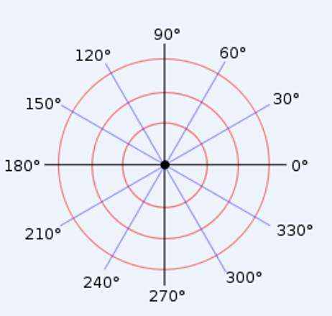
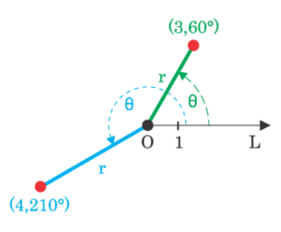
Polar coordinates
On a plane, a fixed point O is selected and called the pole. A ray Ox starting from O is called the polar axis. A unit length is also determined, and it is usually stipulated that the counterclockwise direction is positive for angles. In this way, the position of any point P on the plane can be determined by the length ρ of the line segment OP and the angle θ from Ox to OP. The ordered pair (ρ, θ) is called the polar coordinates of point P, denoted as P(ρ, θ); ρ is called the polar radius of point P, and θ is called the polar angle of point P.
x=ρcosθ
y=ρsinθ
θ=arctan(y/x)

Slide 3
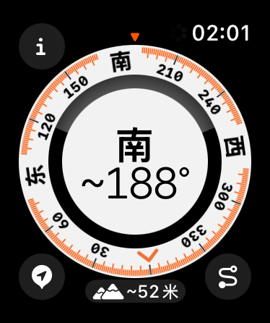
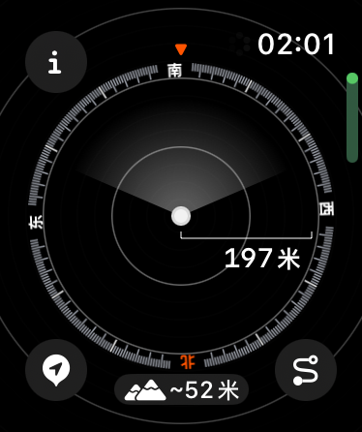
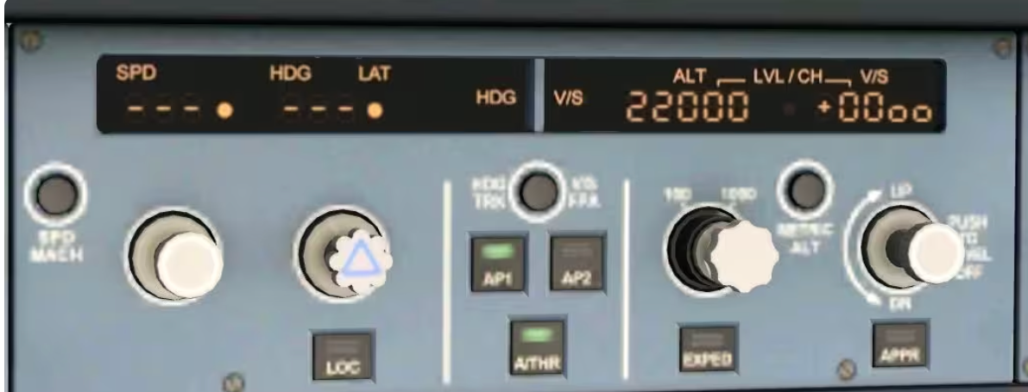
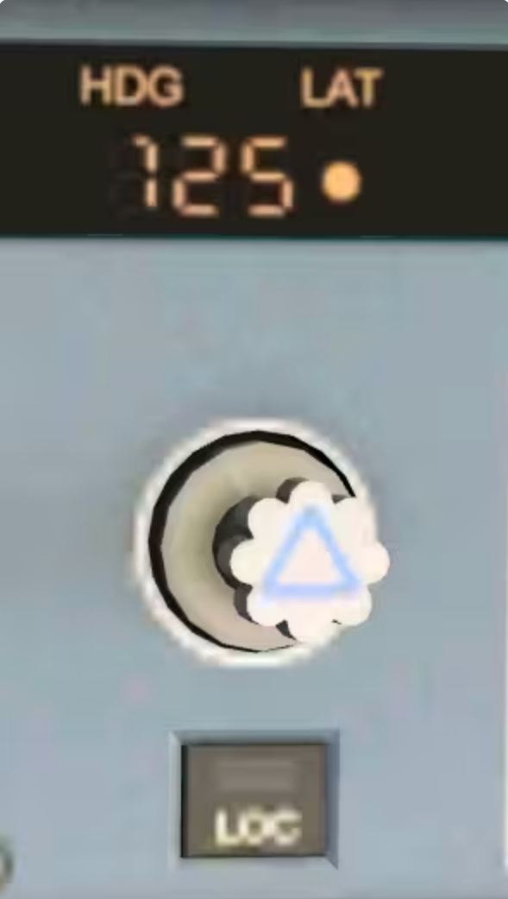
Application
Polar coordinates are typically used in navigation, where the destination or direction of travel can be expressed as the distance and angle from the object under consideration
Aircraft use a slightly modified version of polar coordinates for navigation. In this system, which is commonly used for navigating any kind of aircraft, the 0° ray is generally called heading 360, and the angles continue in a clockwise direction rather than counterclockwise as in the mathematical system. Heading 360 corresponds to the magnetic north pole, while headings 90, 180, and 270 correspond to magnetic east, south, and west respectively. Therefore, an aircraft traveling 5 nautical miles due east would be traveling 5 units on heading 90 (read as 090 by air traffic control).

Slide 4
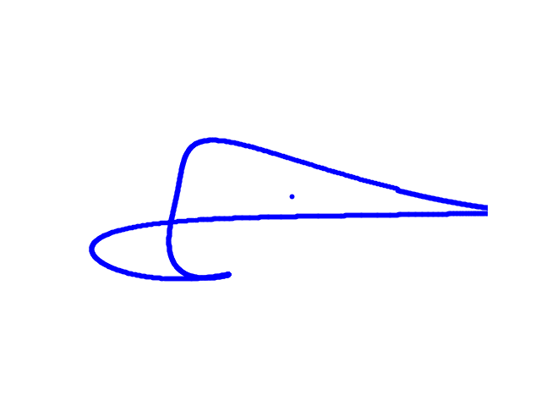
4 params animals
Our lively shrimp

Slide 5
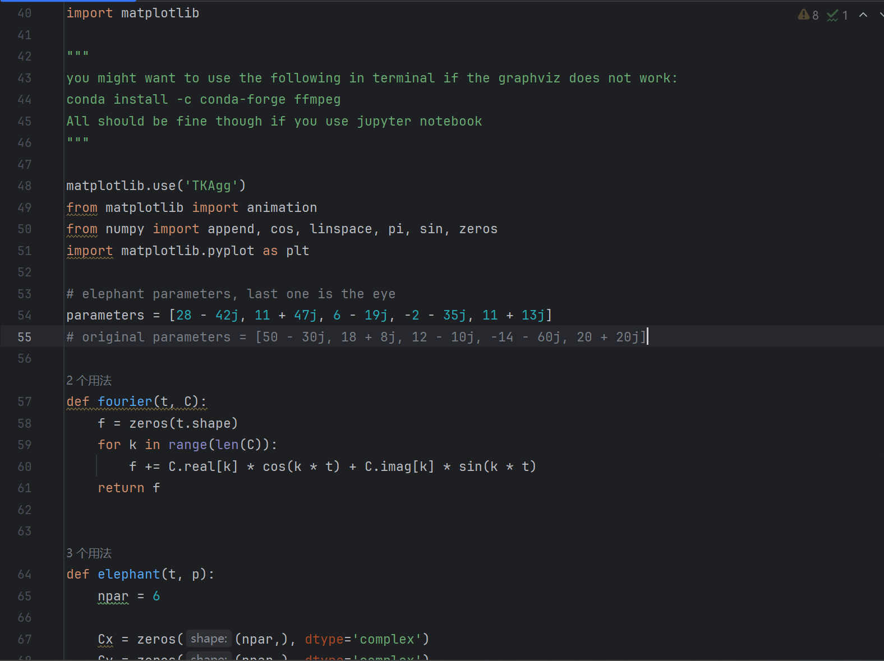
Core parameters display

Slide 6
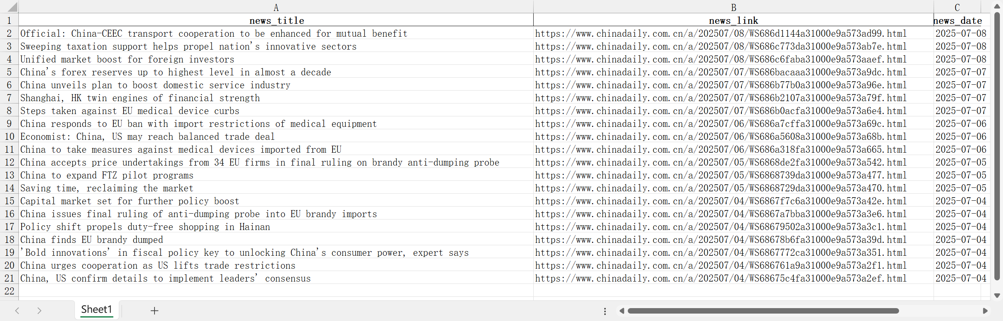
China Daily Business scrape

Slide 7

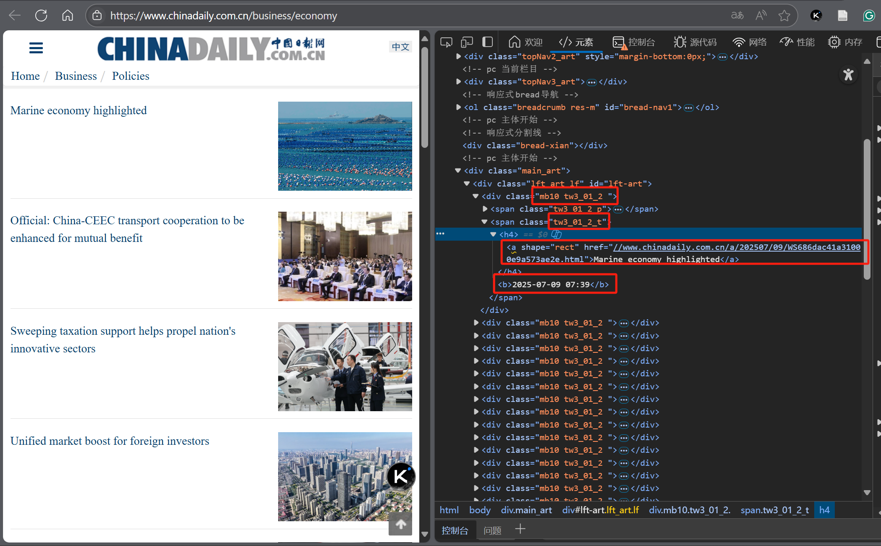
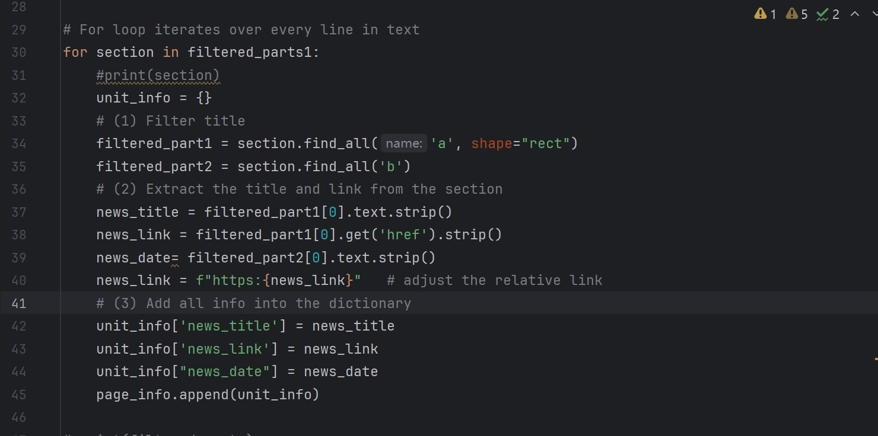
Core code display

